Slide 1
420-D04-SU
Object-oriented programming I Java I
Input/output streams

Slide 2
Streams
Streams consist of an exchange of data between the Java program and another source of data:
Memory
File
Other program
Network (sockets)
…
It is important to position ourselves in relation to our Java program to understand streams.
Inputs (reading data)
Outputs (writing data)
Two types of streams:
Character streams
Byte streams

Slide 3
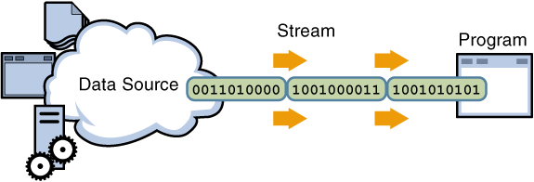
Input streams
When the program reads information from a file or some other data source, it is receiving this information. This is a form of input.
System.in : Standard input stream. Typically supplies keyboard input data.

Slide 4
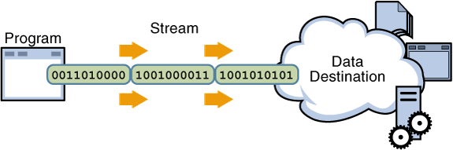
Output streams
When the program writes data to a file or other destination, it is sending the data. This is a form of output.
System.out : Standard output stream. Typically it is printed on the console display.

Slide 5
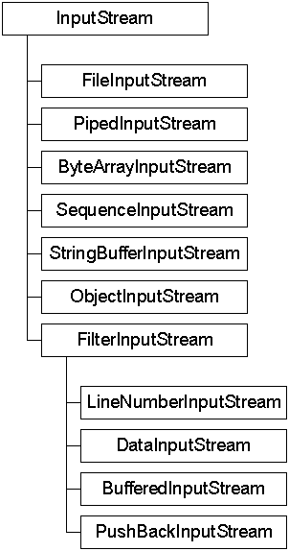
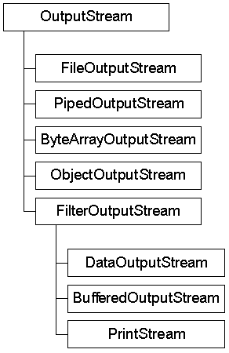
Byte streams: Input/OutputStream
Classes that manage byte streams inherit from one of two abstract classes: InputStream and OutputStream.
There exist many subclasses available for processing byte streams.

Slide 6
Reading a file with a byte stream
FileInputStream in = new FileInputStream("files/myFile.txt");
int character;
byte[] buffer = new byte[8];
while((character = in.read(buffer)) != -1)
{
for (byte b : buffer)
System.out.print((char)b);
buffer = new byte[8];
}
Use read() or read(byte[]). This will send us a sequence of Unicode values. In order to obtain the characters, we have to cast to char.

Slide 7
Writing to a file with a byte stream
FileOutputStream out = new FileOutputStream(
new File("files/myFile.txt"));
String msg = "Hello class, I want to write this \ntext into a file \nas an example.";
char[] myMsg = msg.toCharArray();
for (char c : myMsg)
{
out.write(c);
}
Here we can write into a file using write(int) or write(byte[]).

Slide 8
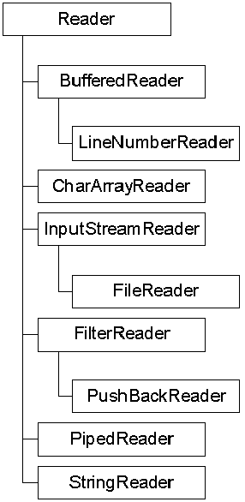
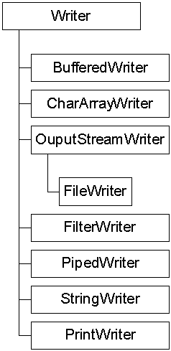
Character streams: Reader/Writer
The classes that manage character streams inherit from one of two abstract classes: Reader and Writer.
There exist many subclasses available for processing character streams.

Slide 9
Reading a file with a character stream
FileReader in = new FileReader(new File("files/myFile.txt"));
int c;
while ( (c = in.read()) > 0)
System.out.print((char)c);
Very similar to byte stream.
Better solution: use a buffered character stream.
BufferedReader file = new BufferedReader(new FileReader("files/myFile.txt"));
String line;
while((line = fichier.readLine())!= null)
System.out.println(line);

Slide 10
Writing to a file with a character stream
PrintWriter out = new PrintWriter(new File("files/myFile.txt"));
out.println("I’m writing a line directly with a String");
out.println("and now a second line");
out.println("and also some numbers: 4, 5, 6, 7, 99, 365");
out.close(); // line is very important for saving the text
Since Java 7, we can use this notation to avoid having to manually close or flush: try-with-resources statement.
try (PrintWriter out = new PrintWriter(new File("files/monFichier.txt")))
{
out.println("I’m writing a line directly with a String");
out.println("and now a second line");
out.println("and also some numbers: 4, 5, 6, 7, 99, 365");
}

